Slide 1
After putting in a blazing performance on the benchmark test,
Sun issued a glowing press release claiming that it had
outperformed Windows NT systems on the test.
Pendragon president Ivan Phillips cried foul, saying the results
weren't representative of real-world Java performance and that
Sun had gone so far as to duplicate the test's code within Sun's
Just-In-Time compiler. That's cheating, says Phillips, who claims
that benchmark tests and real-world applications aren't
the same thing.
Did Sun issue a denial or a mea culpa? Initially, Sun neither
denied optimizing for the benchmark test nor apologized for
it. "If the test results are not representative of real-world Java
applications, then that's a problem with the benchmark,"
Sun's Brian Croll said.
After taking a beating in the press, though, Sun retreated and
issued an apology for the optimization.[Excerpted from PC Online 1997]

Slide 2
Processor Comparisons
AMD Athlon
Intel Itanium

Slide 3
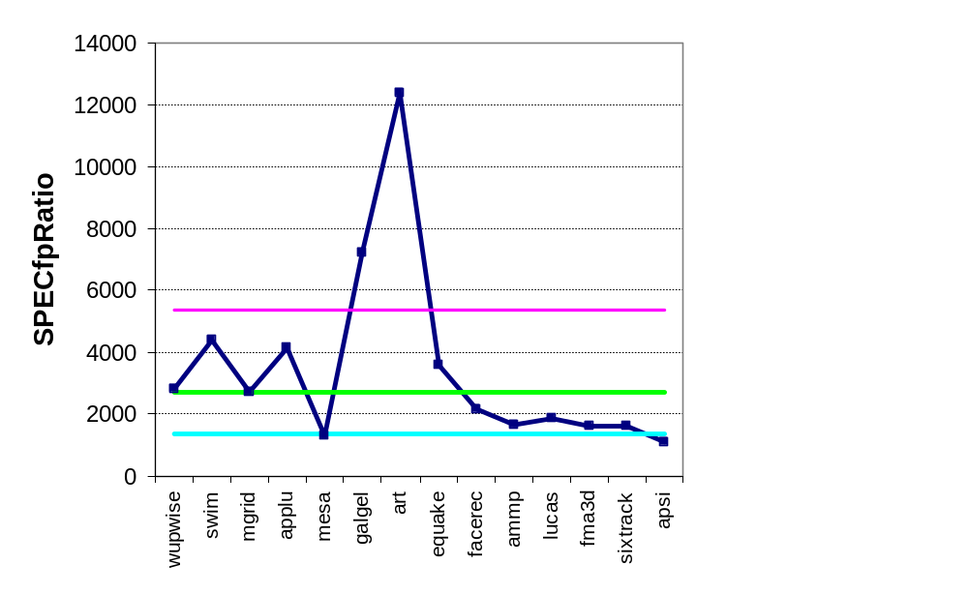
Example Standard Deviation (1/2)
GM and multiplicative StDev of SPECfp2000 for Itanium 2

Slide 4
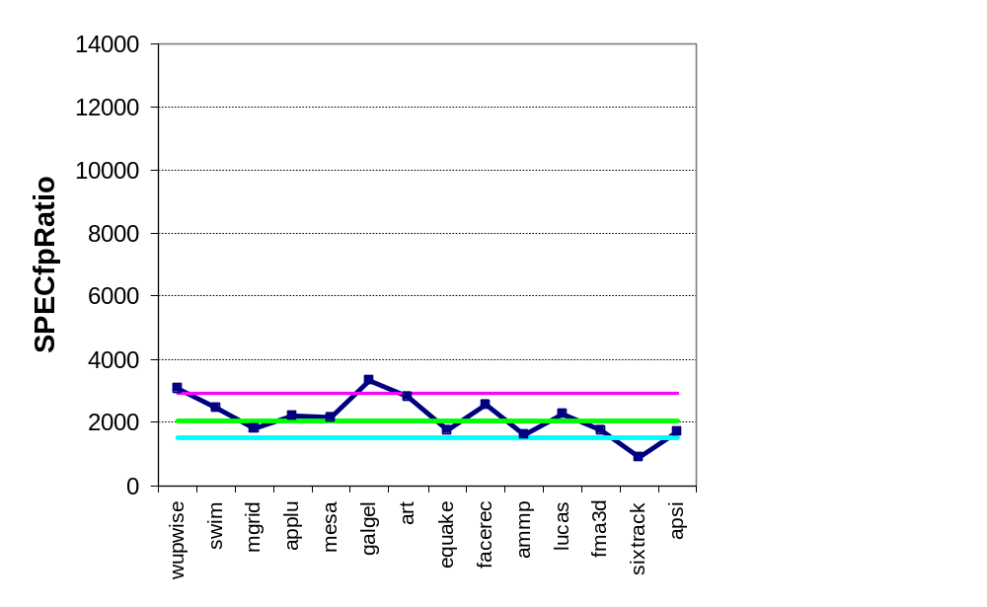
Example Standard Deviation (2/2)
GM and multiplicative StDev of SPECfp2000 for AMD Athlon

Slide 5
Comments on Itanium 2 and Athlon
Standard deviation of 1.98 for Itanium 2 is much higher-- vs. 1.40--so results will differ more widely from the mean, and therefore are likely less predictable
Falling within one standard deviation:
  10 of 14 benchmarks (71%) for Itanium 2
  11 of 14 benchmarks (78%) for Athlon
Thus, the results are quite compatible with a lognormal distribution (expect 68%)

Slide 6
Amdahl’s Law

Slide 7
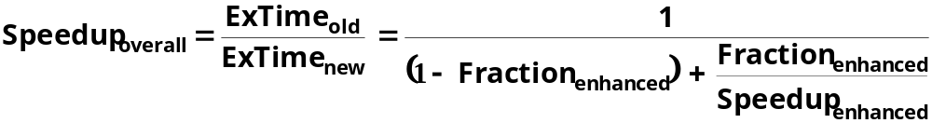
Amdahl’s Law
Best you could ever hope to do:

Slide 8
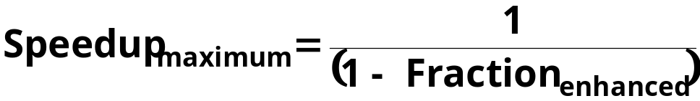
Amdahl’s Law
Best you could ever hope to do:

Slide 9
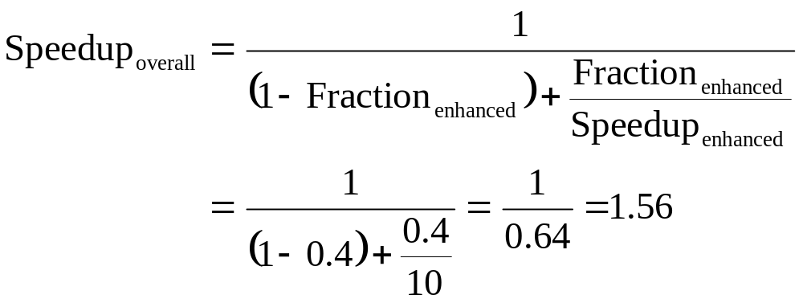
Amdahl’s Law example
New CPU 10X faster
I/O bound server, so 60% time waiting for I/O
Apparently, its human nature to be attracted by 10X faster, vs. keeping in perspective its just 1.6X faster

Slide 10
Processor performance equation
CPI
inst count
Cycle time
CPU time = Seconds = Instructions x Cycles x Seconds
Program Program Instruction Cycle
Inst Coun CPI Clock Rate
Program X
Compiler X (X)
Inst. Set. X X
Organization X X
Technology X

Slide 11
Amdahl’s Law:
CPI Law:
Execution time is the REAL measure of computer performance!
Good products created when have:
  Good benchmarks, good ways to summarize performance
1
ExTime_{old}
ExTime_{new}
Speedup_{overall} =
=
(1 - Fraction_{enhanced}) + Fraction_{enhanced}
Speedup_{enhanced}
CPU time = Seconds = Instructions x Cycles x Seconds
Program Program Instruction Cycle

Slide 12
Metrics of Performance
Application
Operations per second
Programming
Language
Compiler
(millions) of Instructions per second: MIPS
(millions) of (FP) operations per second: MFLOP/s
ISA
Datapath
Control
Megabytes per second
Function Units
Transistors
Wires
Pins
Cycles per second (clock rate)

